Slide 1


Ad Hoc Insights Domain: Consumer Goods | Function: Executive Management
Saramsa Prasad Sherchan

Slide 2
CONTENTS
Problem statement
Task & Resources Provided
Global markets
Product division
Ad Hoc Requests

Slide 3
Problem statement
Atliq Hardware operates as a leading computer hardware producer in India and other global markets.
The company lacks timely and insightful data for decision-making.
To address this, Atliq plans to expand its data analytics team by hiring junior analysts proficient in SQL and possessing essential soft skills.
The absence of a standardized evaluation method poses a challenge in identifying suitable candidates.
There is a need to develop an efficient assessment framework, such as a SQL challenge, to streamline the hiring process.

Slide 4
Task & Resources Provided
Task
Resources
Review 'ad-hoc-requests.pdf' for 10 business requests.
Use SQL queries to address these requests.
Create a presentation for top-level management.
Prioritize creativity; consider audio/video formats.
Dataset.
Metadata.
Hints.
Sample questions/presentations.

Slide 5
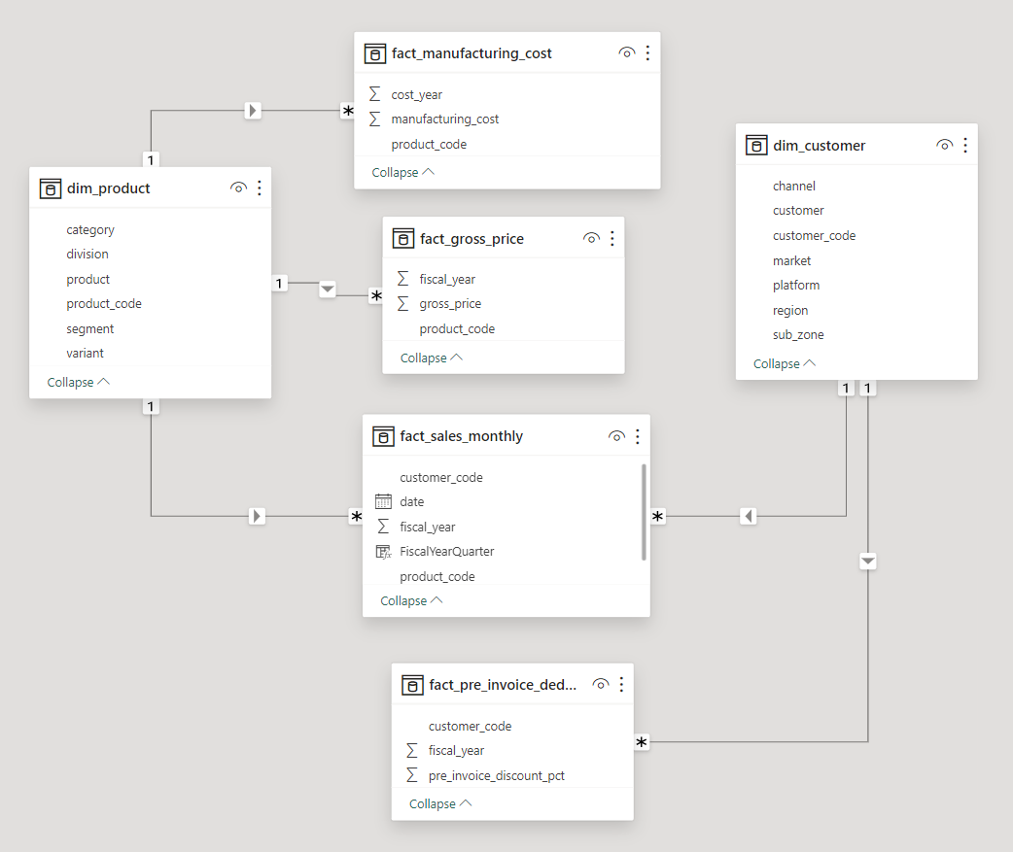
Data Model

Slide 6
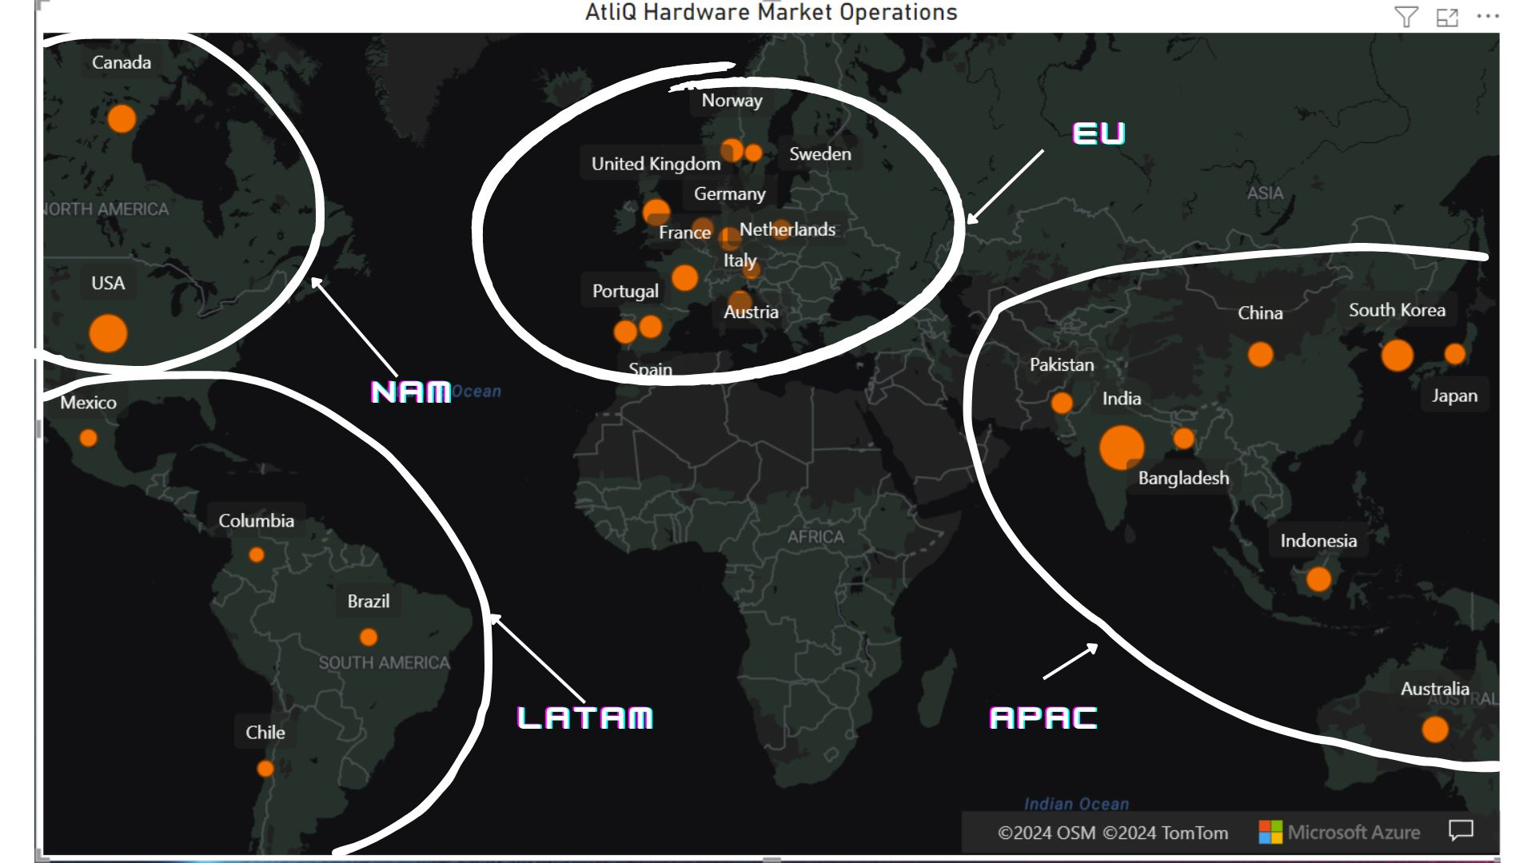
Global Market

Slide 7
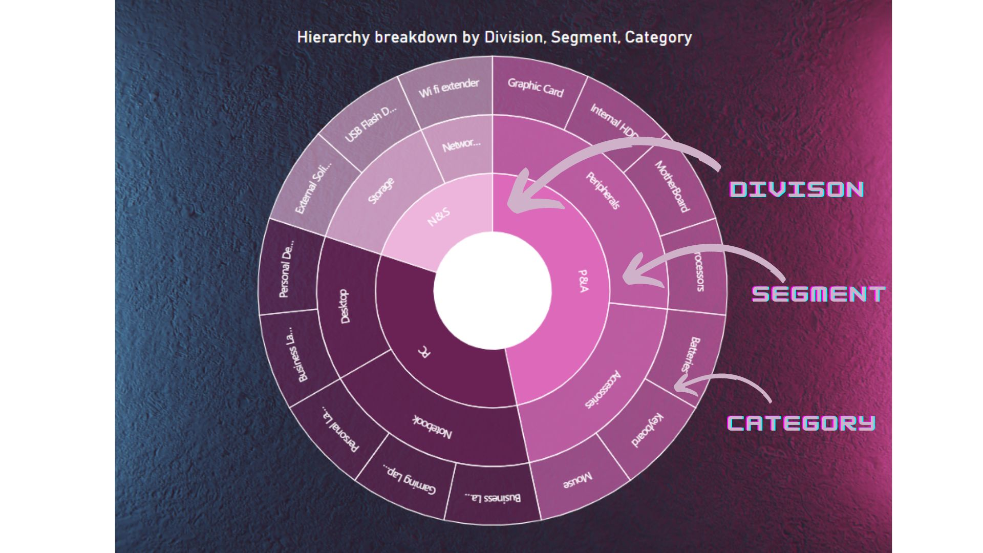
Product Division

Slide 8
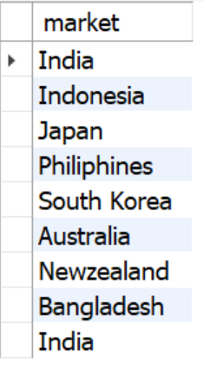
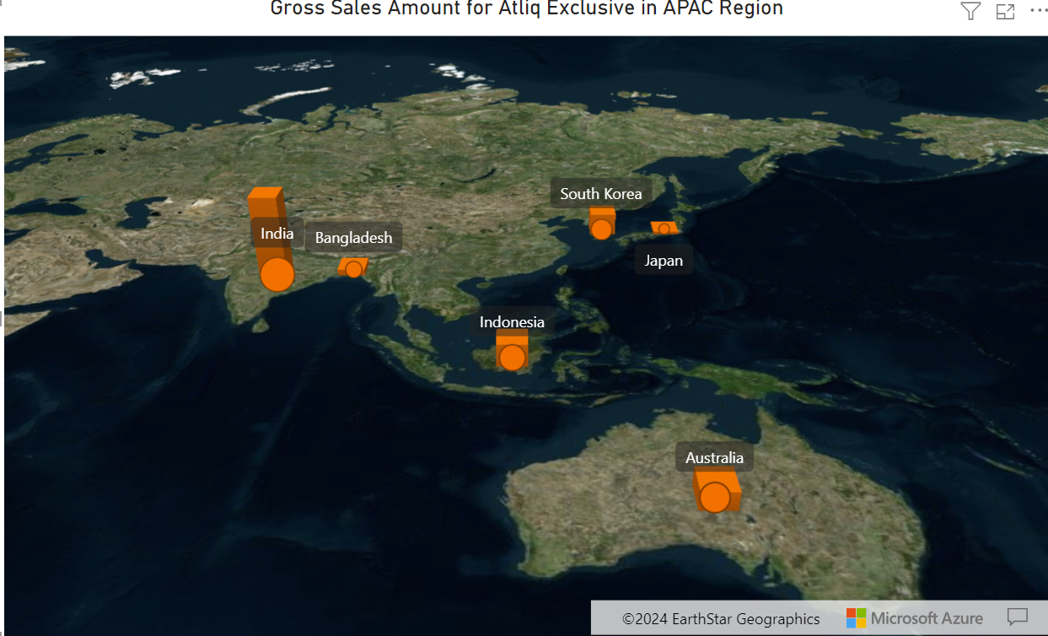
Ad Hoc Req 1
Provide the list of markets in which customer "Atliq Exclusive" operates its business in the APAC region.

Slide 9
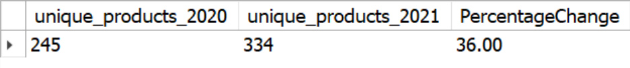
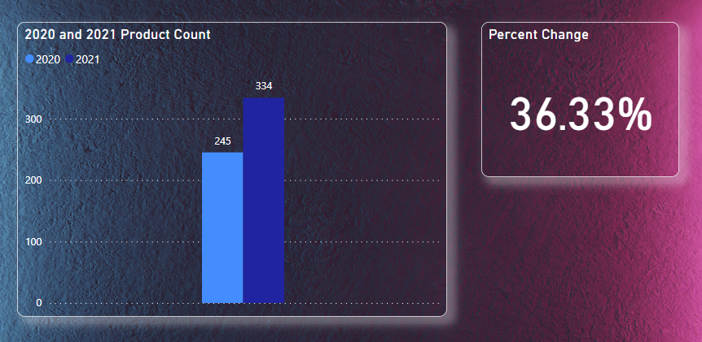
Ad Hoc Req 2
What is the percentage of unique product increase in 2021 vs. 2020?
Demand as well as production has increased.
Indicated growth rate.

Slide 10
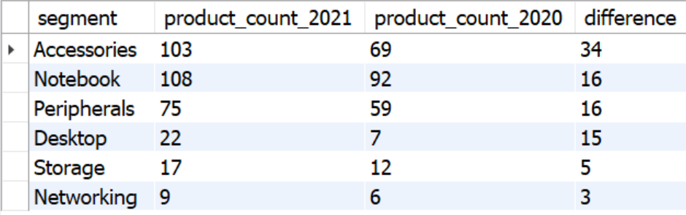
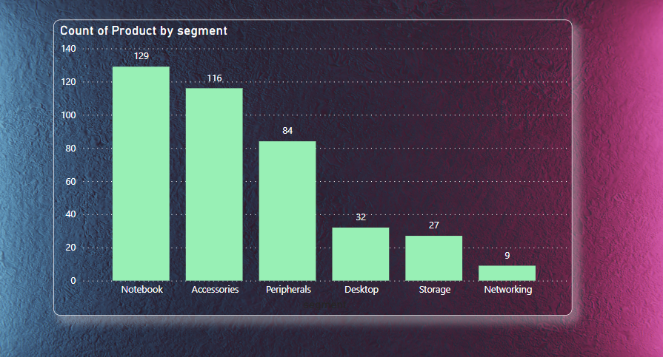
Ad Hoc Req 3
Provide a report with all the unique product counts for each segment and sort them in descending order of product counts.
Accessories, Notebooks, and Peripherals have a significant number of products compared to desktops, storage, and networking.
The top three segments account for 83% of all products.

Slide 11
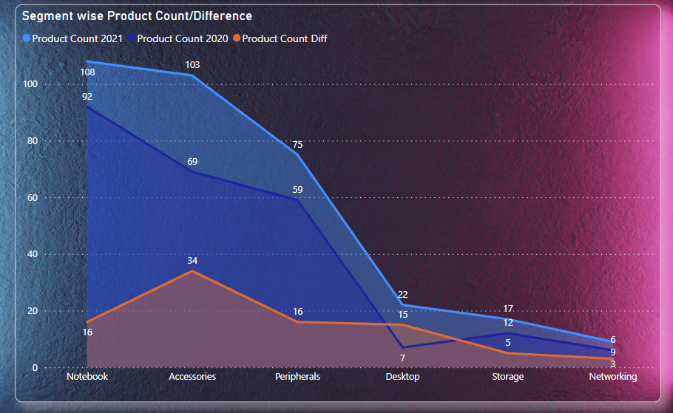
Ad Hoc Req 4 (Follow UP)
Follow-up: Which segment had the most increase in unique products in 2021 vs 2020?
During the transition from 2020 to 2021, the accessories segment saw the largest increase in new products, rising from 69 to 103. Meanwhile, the Networking segment experienced a mere 3-product increase.
Despite the highest surge occurring in Accessories, the Notebook segment maintained the highest number of products for both the years.

Slide 12
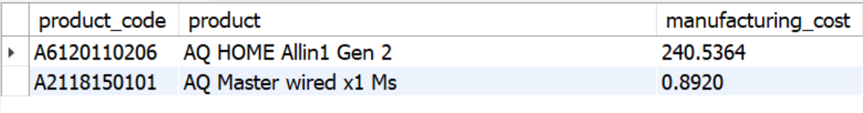
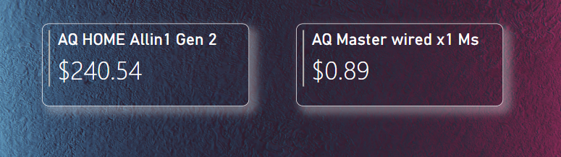
Ad Hoc Req 5
Get the products that have the highest and lowest manufacturing costs.
Mouse : AQ Master wired x1 MS (Variant 1) has the lowest manufacturing cost.
Personal Desktop : AQ HOME ALLin1 Gen 2 (Variant Plus : 3) has the highest manufacturing cost.

Slide 13
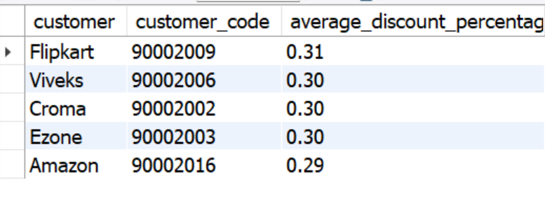
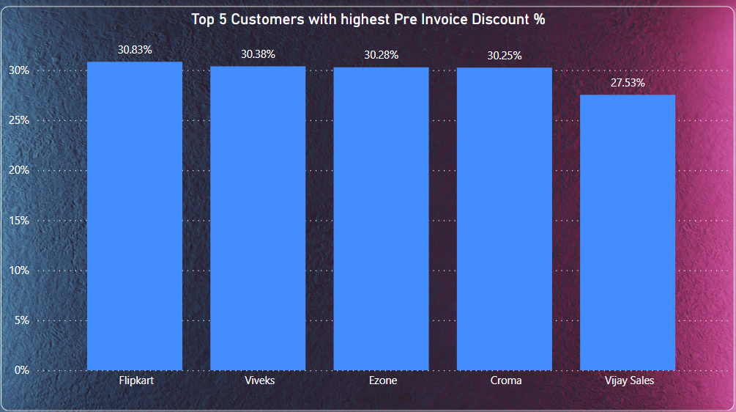
Ad Hoc Req 6
Generate a report which contains the top 5 customers who received an average high pre_invoice_discount_pct for the fiscal year 2021 and in the Indian market.
Among the top 5 customers with the highest average Pre-Invoice discount percentages, Flipkart ranked 1st with 30.83%, while Vijay Sales ranked 5th with 27.53%.

Slide 14
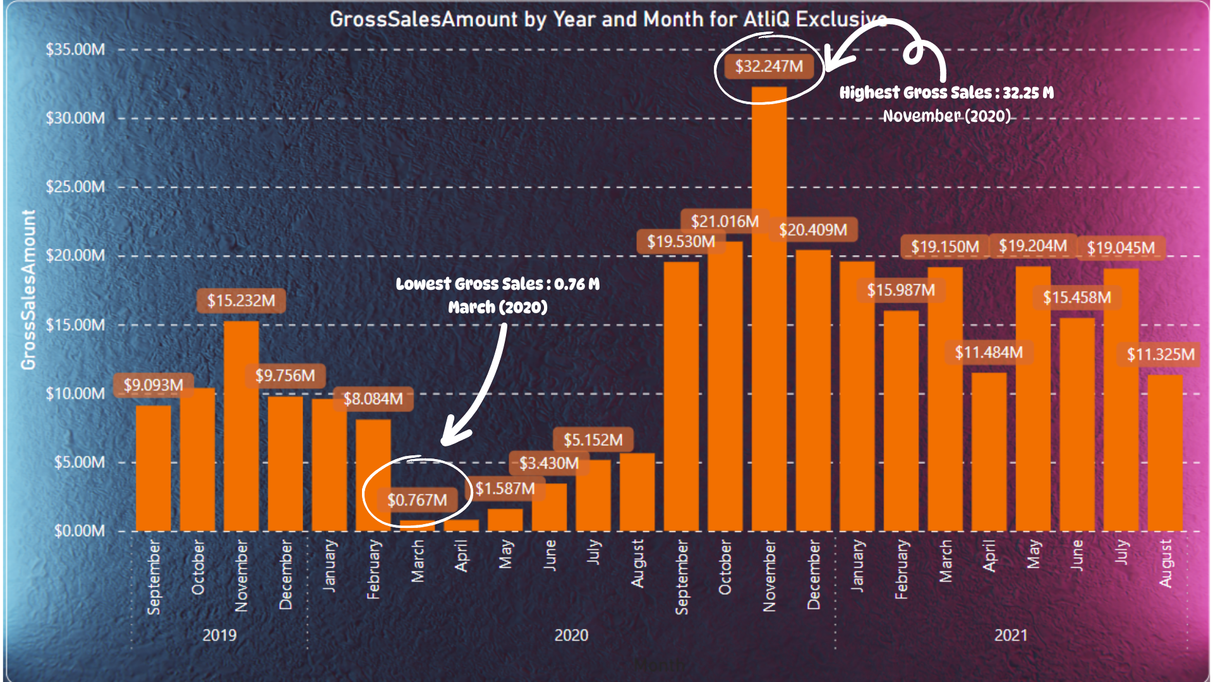
Ad Hoc Req 7
Get the complete report of the Gross sales amount for the customer “Atliq Exclusive” for each month .
Atliq Exclusive recorded its highest gross sales amount in November 2020, totaling $32.25 million.
In March of the same year, it had its lowest gross sales of $0.76 million.

Slide 15
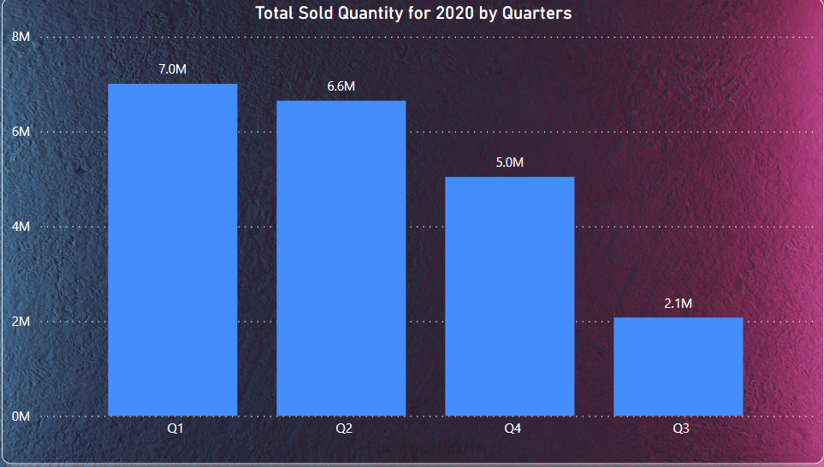
Ad Hoc Req 8
In which quarter of 2020, got the maximum total_sold_quantity
The first quarter (Sept, Oct, Nov) of 2020 resulted with highest quantity of product sold with 7.0 M.
The third quarter (March, April, May) resulted with the lowest number of products sold with 2.1 M.
Q1 alone results to over 34 % of total products sold in 2020.

Slide 16
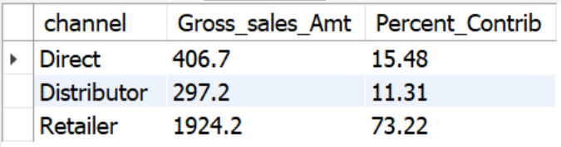
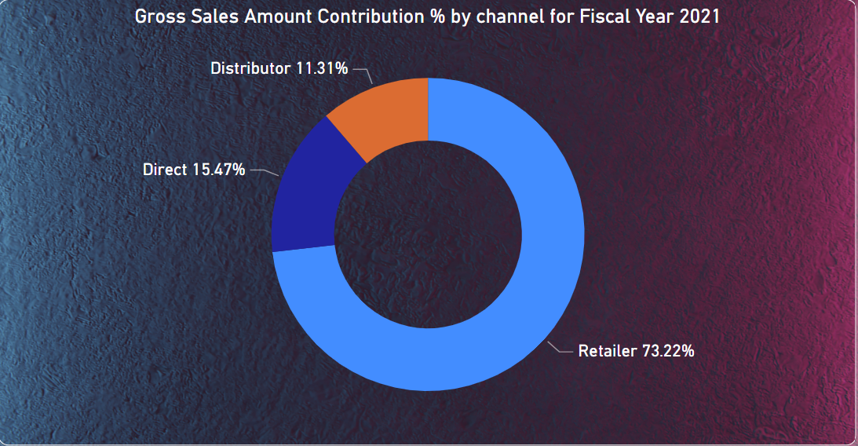
Ad Hoc Req 9
Which channel helped to bring more gross sales in the fiscal year 2021 and the percentage of contribution?
The Retailer channel accounted for the highest gross sales contribution, totaling over $1924 million (73%).
The Distributor channel had the lowest contribution, amounting to $297 million (11%).

Slide 17
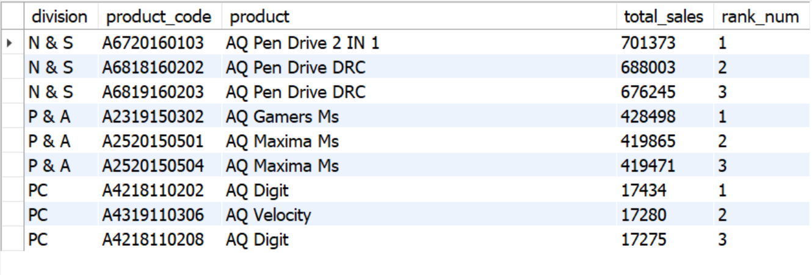
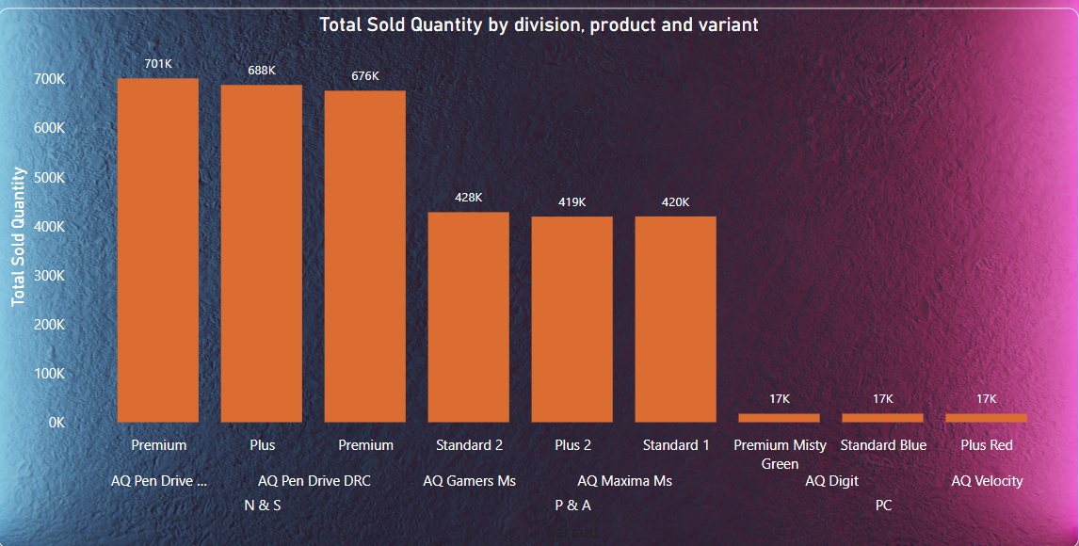
Ad Hoc Req 10
Get the Top 3 products in each division that have a high total_sold_quantity in the fiscal year 2021
All the top 3 selling products in each numbers have similar numbers.
Another interesting fact is that for each division, there is a product with two of its variant among top 3.

Slide 18

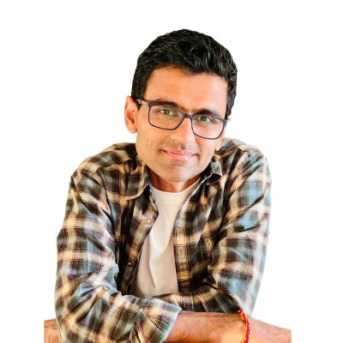

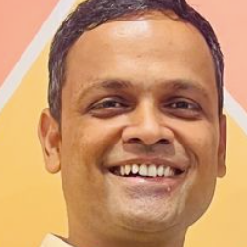
Special thanks
Dhaval Patel AKA Peter Pandey
Hemanand Vadivel AKA Tony Sharma
Bhavin Patel AKA
Bruce Haryali

Slide 19
THANK YOU
Saramsa Prasad Sherchan
ssaramsa@gmail.com
https://codebasics.io/portfolio/Saramsa-Sherchan
https://www.linkedin.com/in/saramsa425/

